Slide 1
Tower Defense Game
Ubisoft Next 2021

Slide 2
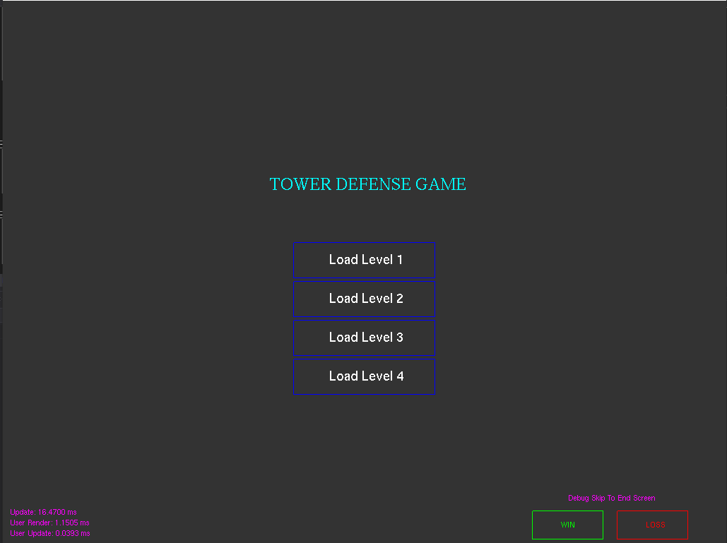
Main Menu
Click one of the buttons to load a level
Optionally use the debug controls in the bottom right to check out the end screen states

Slide 3
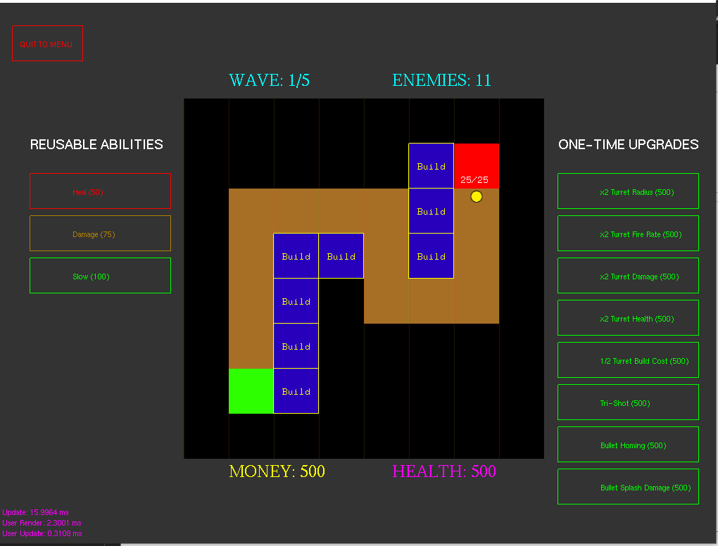
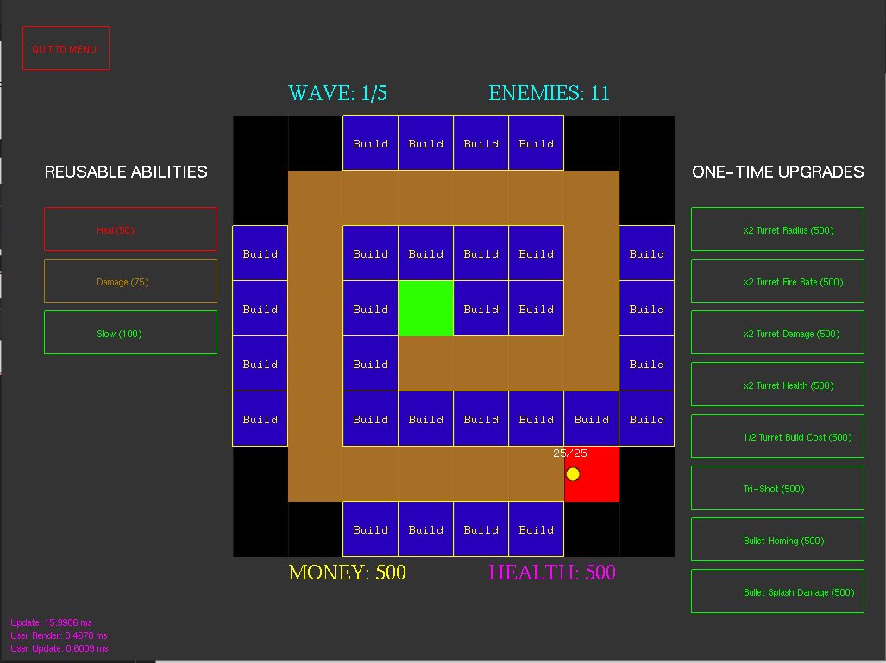
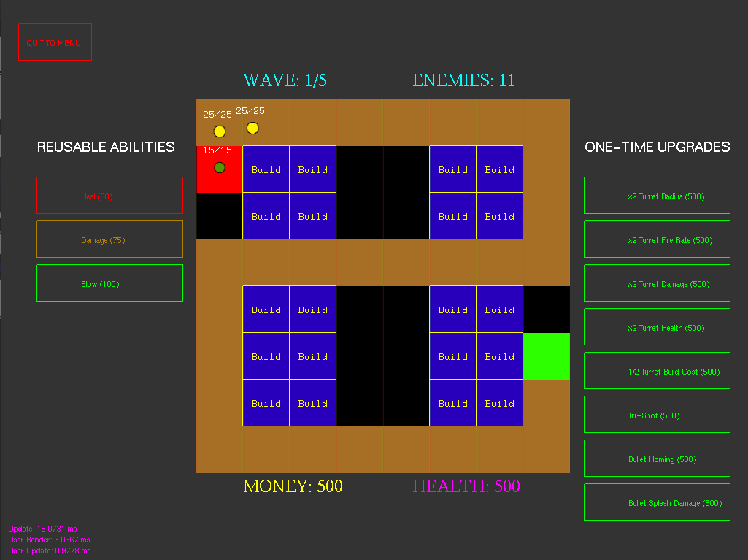
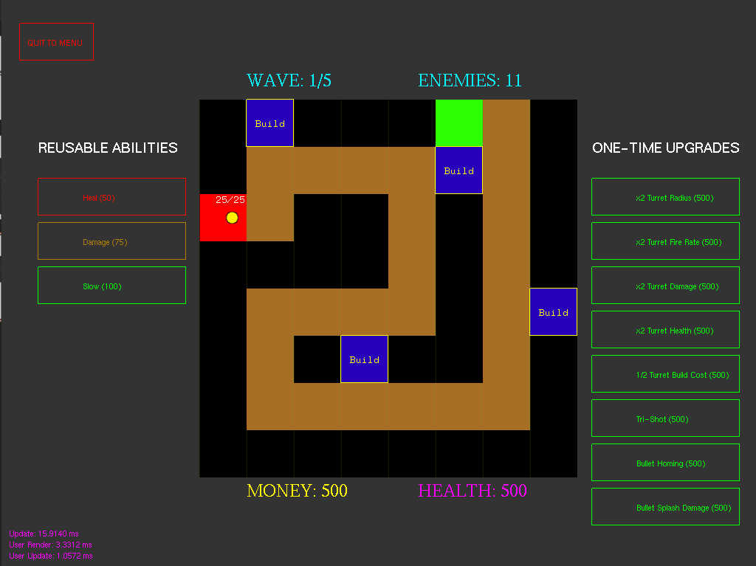
Levels
Enemies spawn on red squares
Player must defend green squares
Enemies move on brown squares
Player can build turrets on blue squares by clicking

Slide 4
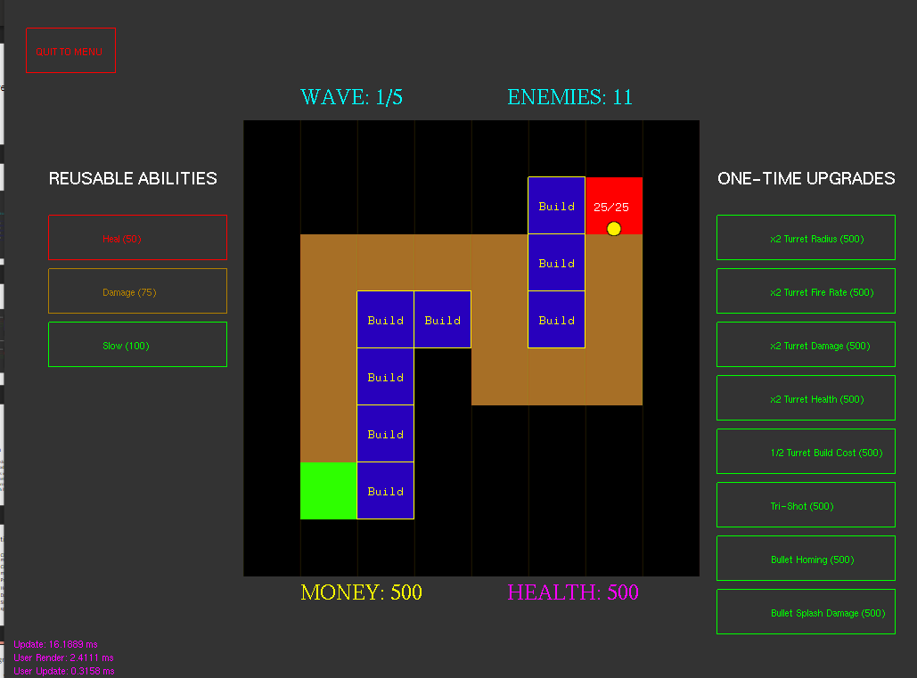
Main UI
Top left -> quit to main menu
Top middle -> wave and enemy count
Left -> abilities
Right -> upgrades
Bottom -> money and health
Middle -> game screen

Slide 5

Enemies
From left to right:
Basic -> just moves around
Fast -> moves quicker
Strong -> more HP, moves slow
Healer -> heals allies in a radius
Speeder -> speeds up allies within radius
EMP -> disables player turrets within radius
Bomber ->damages any turrets with radius when destroyed
Boss -> very slow, very high health, very high damage

Slide 6
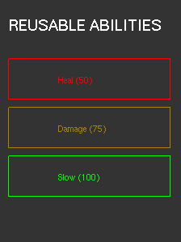
Reusable Abilities
Click button to start ability (need amount of money in brackets)
Circular targeting reticle will appear around the mouse
Press space to trigger ability, right click to cancel
Heal -> heals any turrets in the radius
Damage -> damages any enemies in the radius
Slow -> places a slow field that halves enemy speed for the duration within the radius

Slide 7
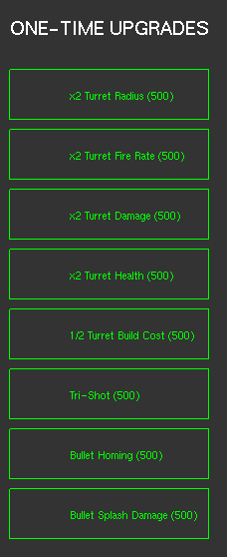
One-Time Upgrades
Click to trigger (need money in brackets)
One-time use, upgrades all current and future turrets
Tri-Shot -> shoots three bullets instead of 1
Bullet homing -> bullets will home on target after a short duration
Bullet splash damage -> when destroyed, bullets will cause damage to enemies within radius

